Slide 1
Sentimental Analysis on Assamese Song Reviews
-By Reckon Mazumdar

Slide 2
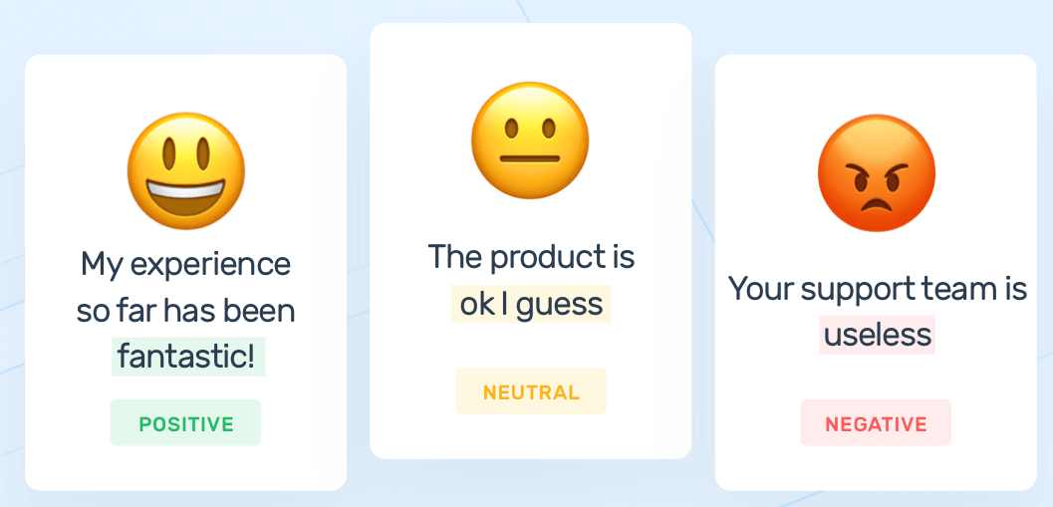
What is sentimental analysis?
Sentiment Analysis is a natural language processing task which helps to identify and categorize opinions expressed in a piece of text as positive, negative or neutral.
Fig 1: Sentimental Analysis [1].

Slide 3
Why sentimental analysis is important?
In the era of technology, each one of us is expressing our opinion on social media platforms very frequently and these opinions are mostly expressed in regional languages, so the contents mostly generated are in regional languages in nature.
So it is important to extract the sentiment from these opinions and use this information in different ways like social media monitoring, customer support management, and analyzing customer feedback.

Slide 4
Why Assamese language?
•Tremendous works in the area of Sentiment Analysis are available for the English language whereas little work has been done in Sentiment Analysis for Indian Languages.
•Web content in Assamese is booming day by day. So sentimental analysis on Assamese will benefit in many ways as mentioned in the previous slide.

Slide 5
Challenges of sentiment analysis in Assamese
Assamese is morphologically rich and a free order language as compared to English language.
Assamese is a resource scarce language which causes problems in collection and generation of datasets.
Very little research work has been done related to Sentiment analysis in Assamese.

Slide 6
Approach
We have used two approaches to classify the sentiment of Assamese reviews as positive or Negative.
IN language Semantic Analysis. : This approach is based on training the classifiers on the same language as text.
Machine Translation Based Semantic Analysis. : In this approach we train the classifier on English reviews and for testing, we translate the Assamese reviews into English using Microsoft Translator API [2] and then we classify the Sentiment of the review.

Slide 7
Dataset Used
We have collected a total of 1028 Assamese songs reviews from youtube comments and manually annotated them as 1( positive) and 0 (negative).
Out of 1028 reviews collected manually, 505 reviews are positive and the rest 523 are negative reviews.
For Machine Translation based approach, using Microsoft Azure Cognitive Services(Translator) [2] the native language reviews are translated to relative English reviews.

Slide 8
In-Language Classification
This approach is based on training the classifiers in the same language as the text. It relies heavily on the availability of resources in the same language to analyze the sentiment. Thus all training text, testing text are in the Assamese language. The feature representation(Term frequency or TF-IDF) can be varied to see the effect on In-language classification on Assamese song reviews. In this approach, we use a variety of classifiers to train and test the data. We know TF-IDF can be a better way of feature matrix generation as it reduces the effect of very frequent words in documents but does not contribute much to the relevance of the text.

Slide 9
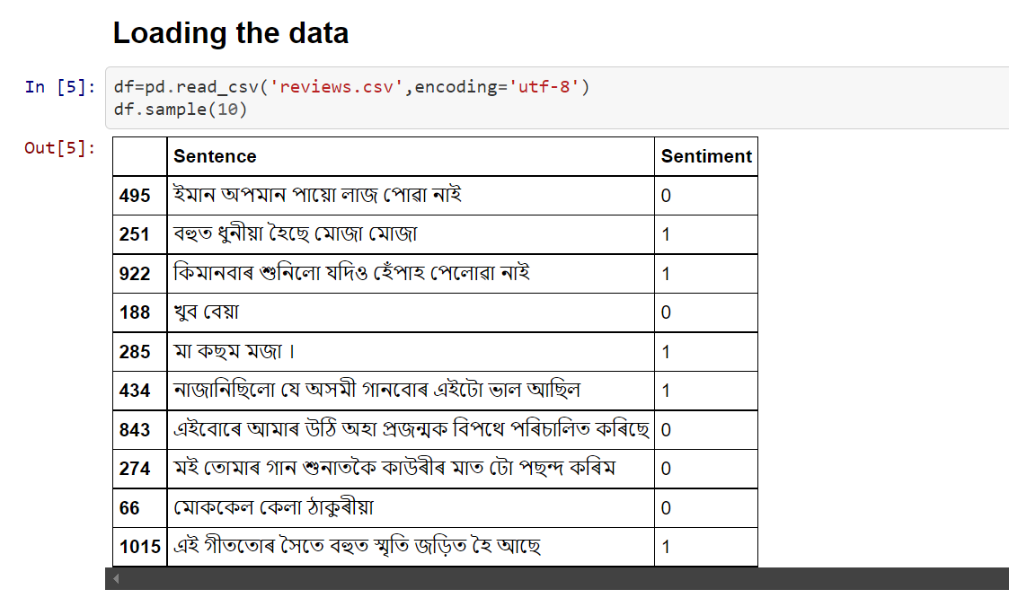

Slide 10
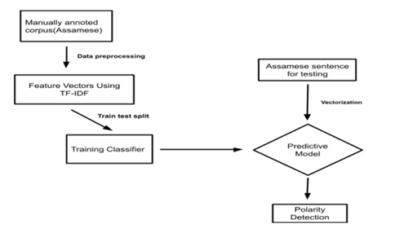
Fig.2: IN-Language classification block diagram

Slide 11
Data preprocessing in In-language approach
Removing the duplicate sentences.
Tokenization of the text using NLTK library [3].
Removing the stopwords [4].
Removing the punctuations and special characters.
Returning the cleaned text.

Slide 12
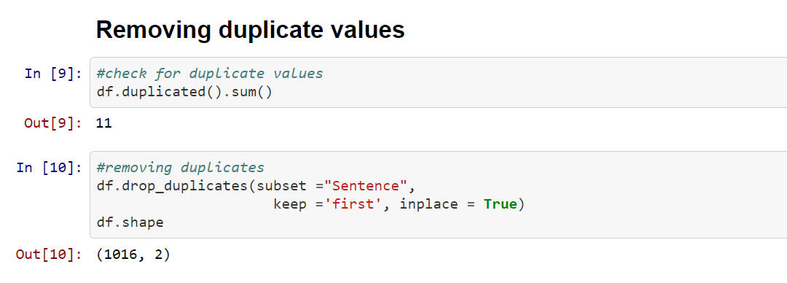

Slide 13
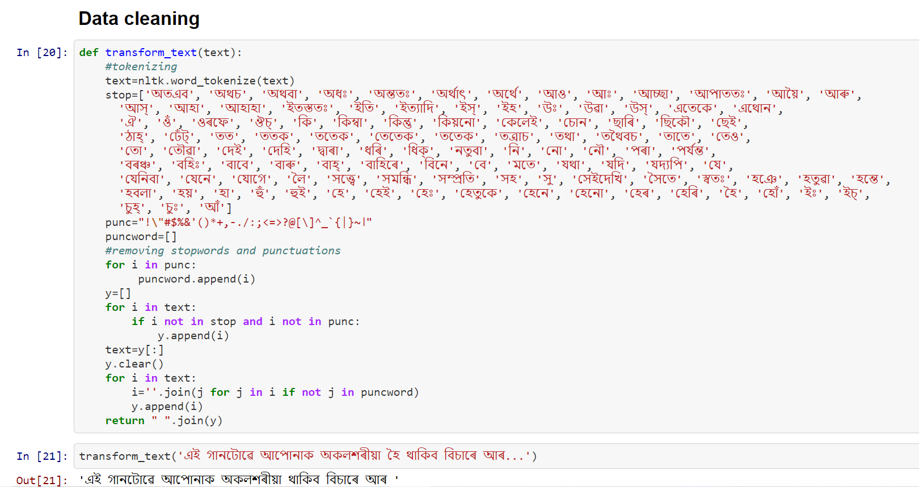

Slide 14
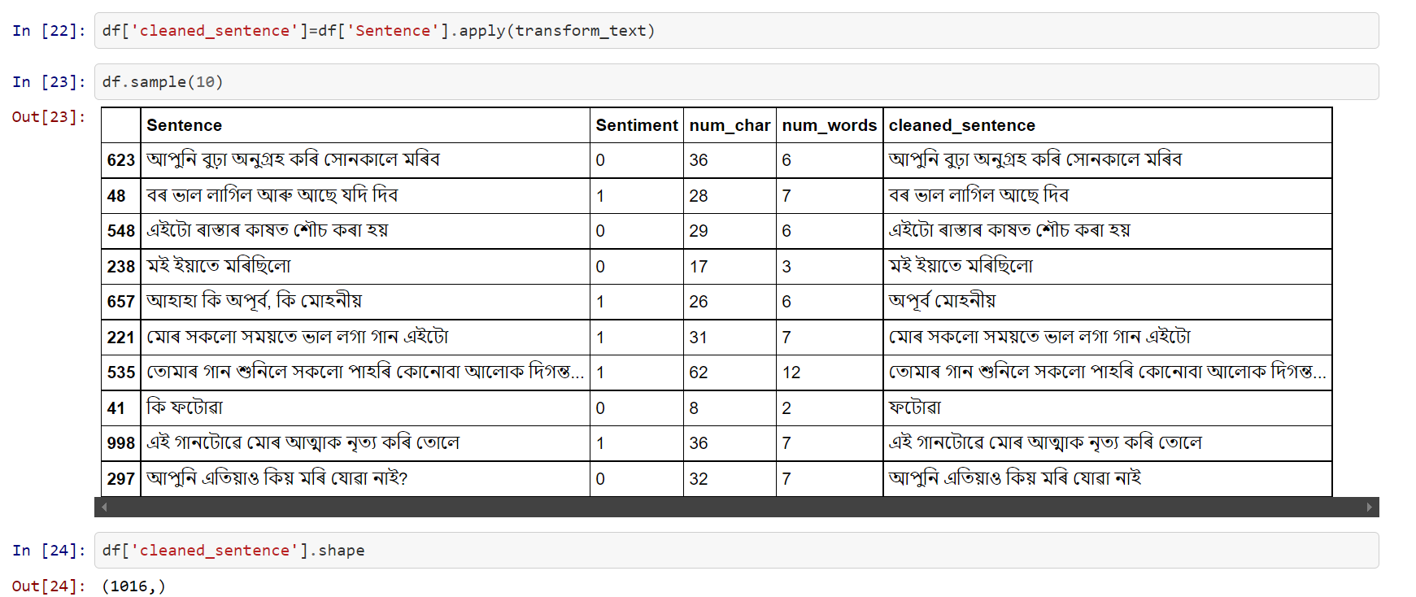

Slide 15
Machine Translation
There is a scarcity of resources in Assamese, like the number of stop words and stemming tools for the Assamese language. Thus it enforced us to take into consideration the machine translation-based sentiment analysis approach. In this approach, we have first translated the entire Assamese language dataset into the English language using Microsoft translator API, then we applied the text pre-processing techniques like removing stop words, punctuations, characters that are not alphanumeric, and stemming which were not properly possible in the previous approach. We have used the bag-of-words (count vectorizer) model for feature matrix generation. Finally, we used a variety of classifiers to train and test the data.

Slide 16
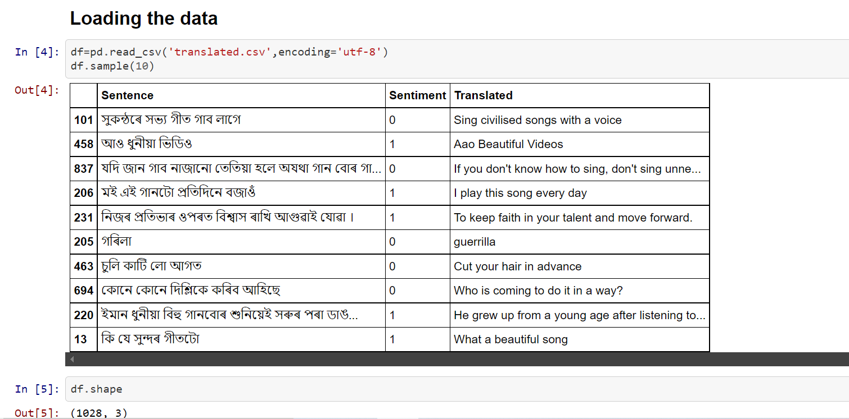

Slide 17
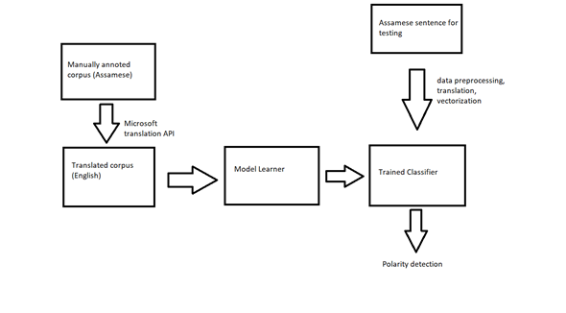
Fig.4: Machine translation based classification block diagram

Slide 18
Data preprocessing in Machine Translation approach
Removing the duplicate sentences.
First the input text is down converted to lowercase .
Tokenization of the text using NLTK library [3].
Keeping Alphanumeric values and stopwords are removed.
Removing the punctuations and special characters.
Finally stemming is done.
Returning the cleaned text.

Slide 19
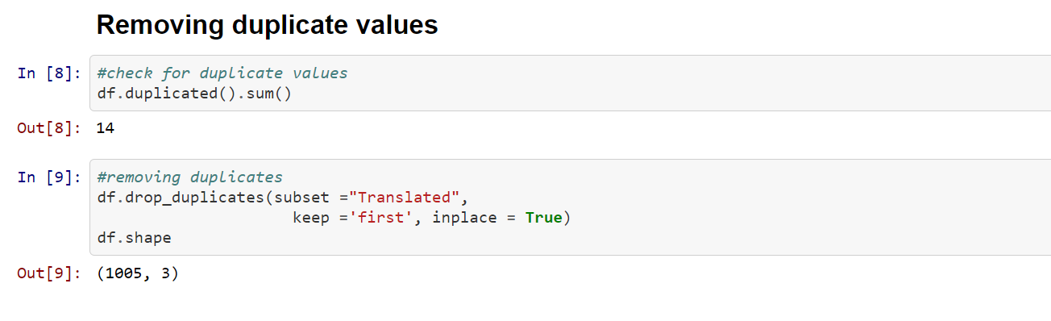

Slide 20
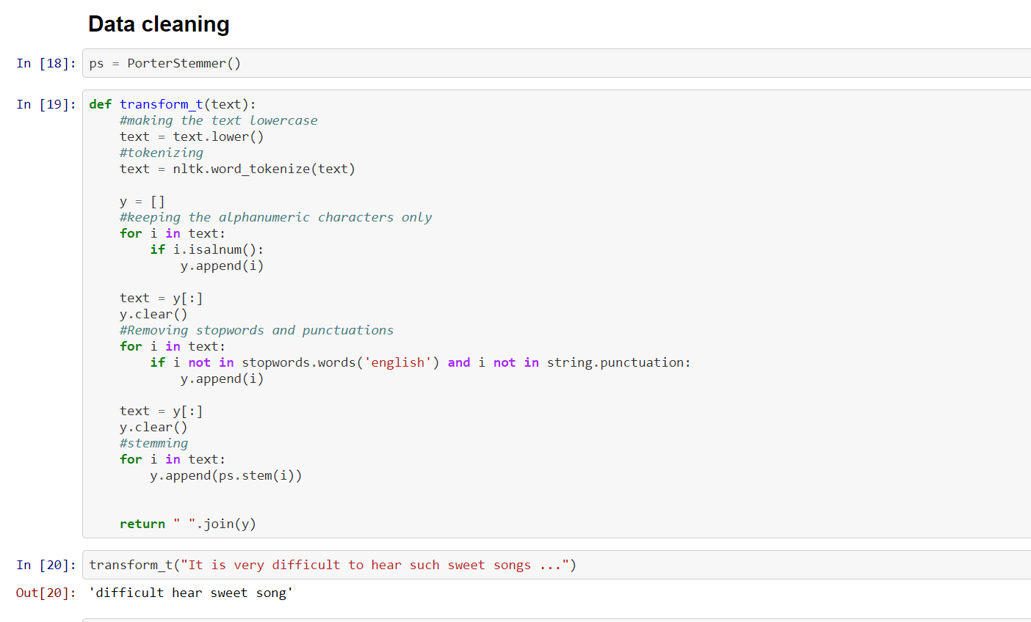

Slide 21
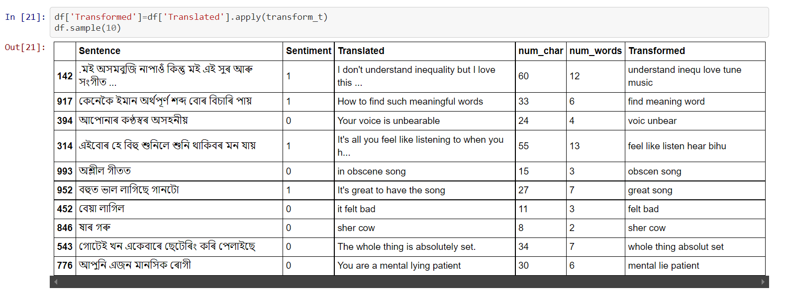

Slide 22
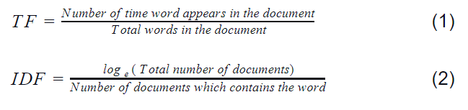
Feature Matrix Generation using TF-IDF
TfidfVectorizer() function available in the scikit-learn library
It is used to convert a collection of raw documents to a matrix of TF-IDF features.
It is a statistical measure to find how important the word is in the document.
Term Frequency (TF) calculates the occurrence of the word in a single document by the total number of words in the document, whereas inverse term frequency (IDF) tries to find how important the word is in all documents [5].

Slide 23
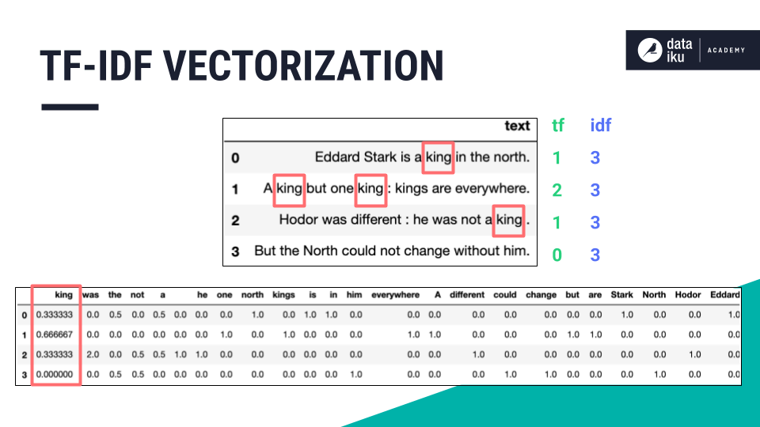
Fig.3: TF-IDF [6].

Slide 24
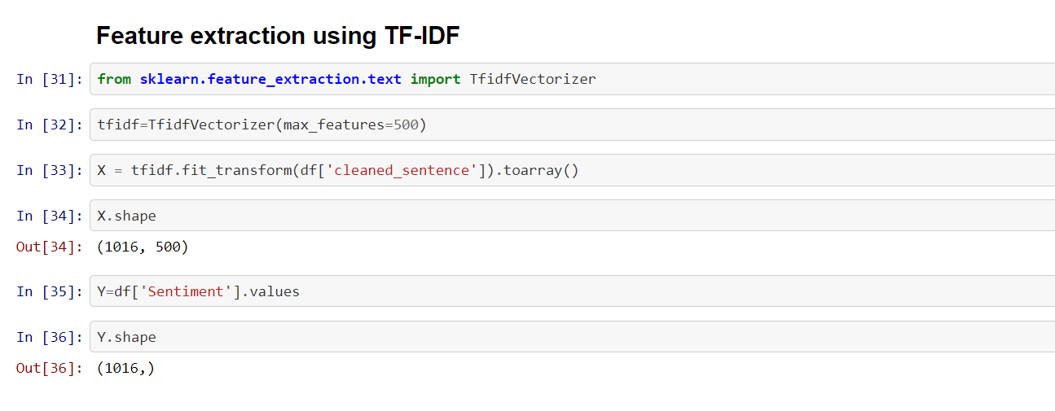

Slide 25
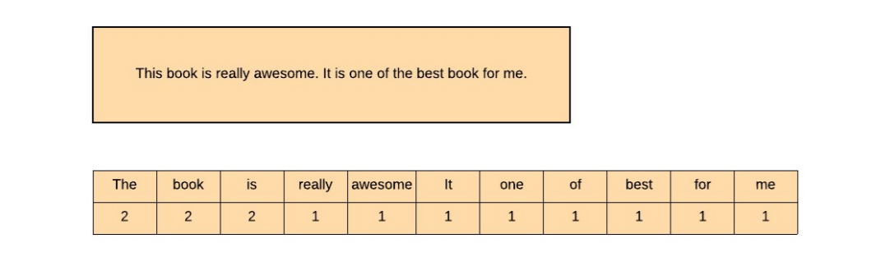
Count Vectorization
Count Vectorization is a vectorization technique in which a document matrix is maintained. The document matrix contains the words present in each document with the frequency of occurrence of that word in the document[5].
Fig.5: illustration of count vectorization [5].

Slide 26
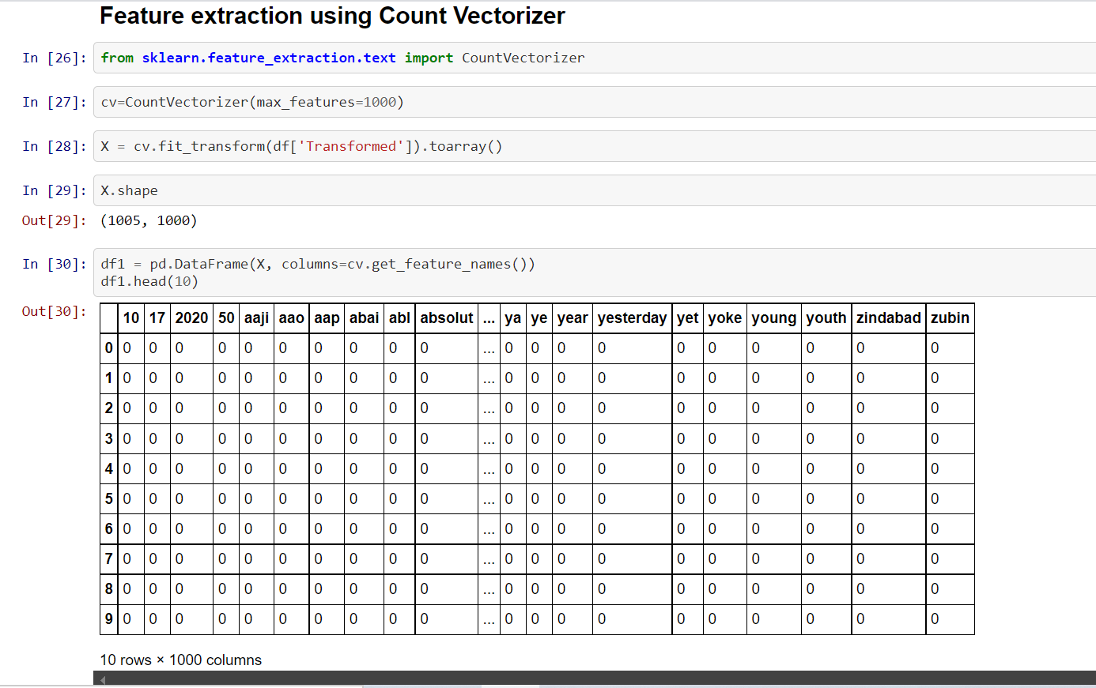

Slide 27
Classification
•We have used various ML classifiers for training our model
Naïve Bayes
Support Vector Machine
Decision Trees
Logistic Regression
Extra Tree Classifier
KNN
Random Forest

Slide 28
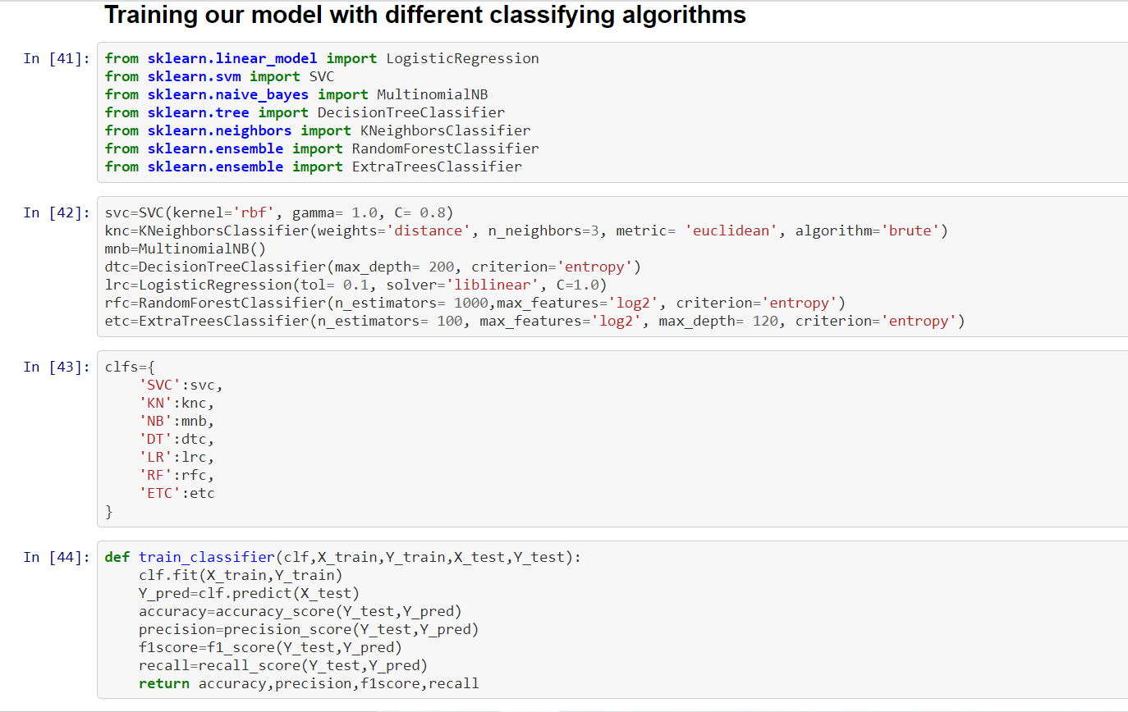

Slide 29
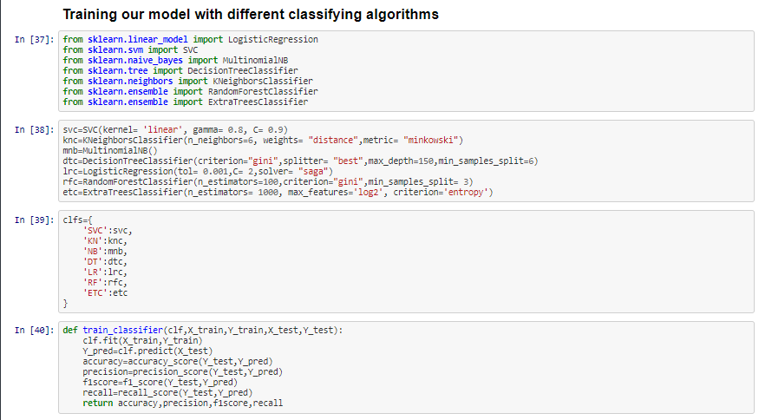

Slide 30
Results and graphical analysis
Once the model is validated and the results are available, the different models are evaluated using different performance metrics. The most common performance evaluation metrics are accuracy , precision , recall , F1-score.
• Accuracy: It is the number of correct predictions over the total number of the instances of data [8].
• Precision: It is the number of the correct positive results over the total number of positive predicted results [8].
• Recall: It is number of correct predicted results over the total number of actual positive results [8].
• F1 score: It is the weighted average of precision and recall [8].

Slide 31
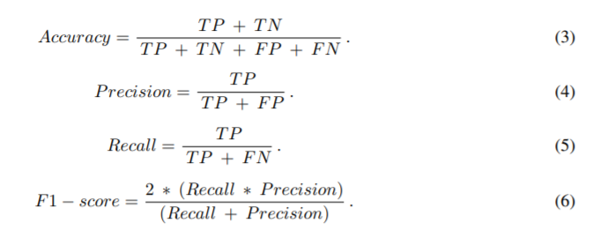
where , TP = Truly predicted positives, TN = Truly predicted negatives , FP = Falsely predicted positives , FN = Falsely predicted negatives.

Slide 32
Accuracy
Classifier Used | In language (%) | Machine Translation (%)
SVM | 77.4% | 83.5%
KNN | 66.6% | 75.1%
Naive Bayes | 74.5% | 86%
Decision Tree | 70% | 81%
Logistic Regression | 76.4% | 87.5%
Random forest | 75% | 81.5%
Extra Trees | 81.3% | 82.5%
Table1: Accuracy obtained with various models using different classifiers

Slide 33
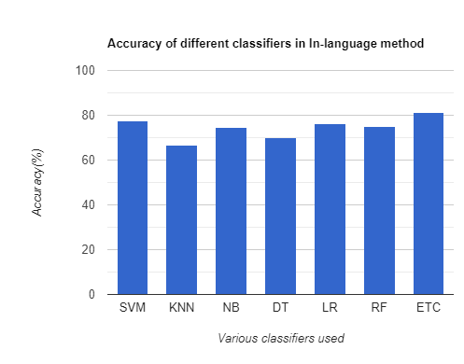

Slide 34
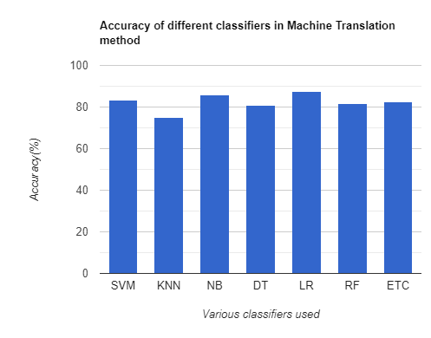

Slide 35
Accuracy, precision, recall and f1 scores of different classifiers obtained in In-language approach
For SVC
Accuracy- 0.7745098039215687
Precision- 0.7222222222222222
F1 Score- 0.7722772277227723
Recall- 0.8297872340425532
For KN
Accuracy- 0.6666666666666666
Precision- 0.782608695652174
F1 Score- 0.5142857142857143
Recall- 0.3829787234042553
For NB
Accuracy- 0.7450980392156863
Precision- 0.6875
F1 Score- 0.7475728155339806
Recall- 0.8191489361702128
For DT
Accuracy- 0.7009803921568627
Precision- 0.6896551724137931
F1 Score- 0.6629834254143647
Recall- 0.6382978723404256
For LR
Accuracy- 0.7647058823529411
Precision- 0.7169811320754716
F1 Score- 0.76
Recall- 0.8085106382978723
For RF
Accuracy- 0.75
Precision- 0.7216494845360825
F1 Score- 0.7329842931937173
Recall- 0.7446808510638298
For ETC
Accuracy- 0.8137254901960784
Precision- 0.7916666666666666
F1 Score- 0.7999999999999999
Recall- 0.8085106382978723

Slide 36
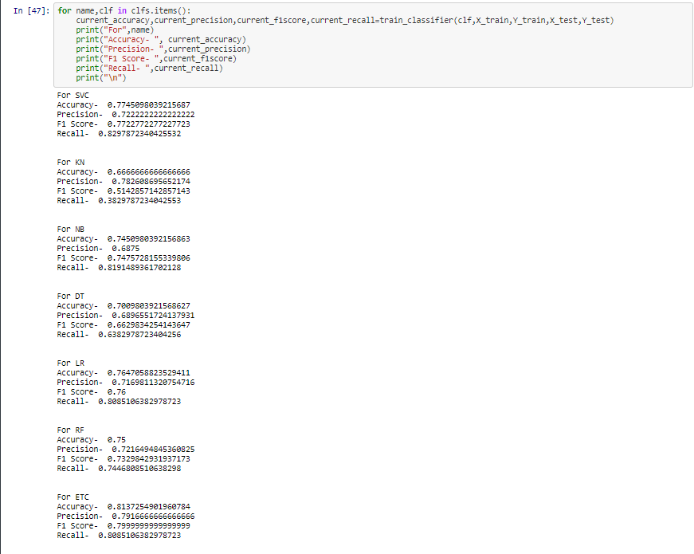

Slide 37
Accuracy, precision, recall and f1 scores of different classifiers obtained in machine translation approach
For SVC
Accuracy- 0.835820895522388
Precision- 0.8202247191011236
F1 Score- 0.8156424581005587
Recall- 0.8111111111111111
For KN
Accuracy- 0.7512437810945274
Precision- 0.7272727272727273
F1 Score- 0.7191011235955056
Recall- 0.7111111111111111
For NB
Accuracy- 0.8606965174129353
Precision- 0.81
F1 Score- 0.8526315789473685
Recall- 0.9
For DT
Accuracy- 0.8109452736318408
Precision- 0.7888888888888889
F1 Score- 0.7888888888888889
Recall- 0.7888888888888889
For LR
Accuracy- 0.8756218905472637
Precision- 0.8571428571428571
F1 Score- 0.861878453038674
Recall- 0.8666666666666667
For RF
Accuracy- 0.8159203980099502
Precision- 0.7849462365591398
F1 Score- 0.7978142076502732
Recall- 0.8111111111111111
For ETC
Accuracy- 0.8258706467661692
Precision- 0.7894736842105263
F1 Score- 0.8108108108108109
Recall- 0.8333333333333334

Slide 38
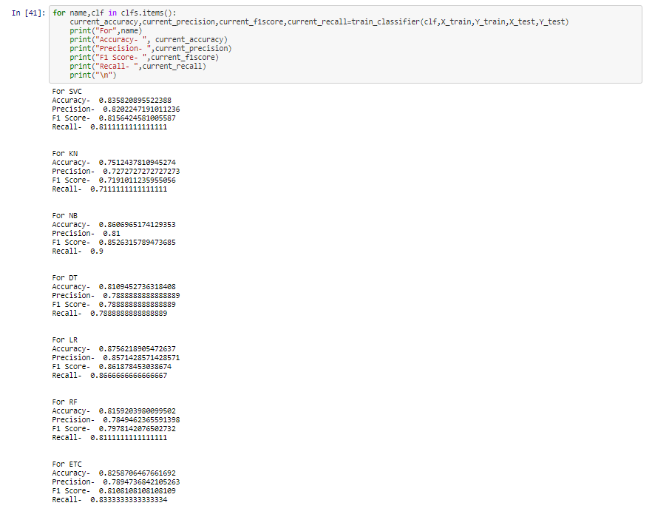

Slide 39
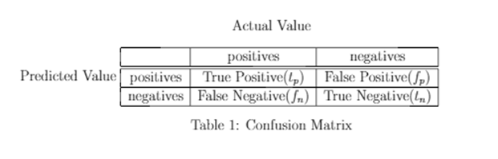
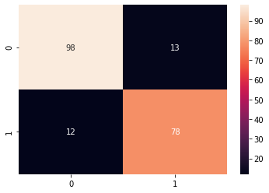
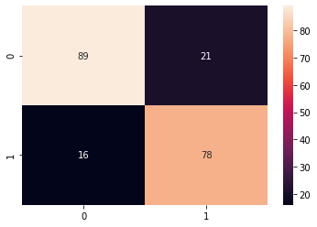
Confusion matrix
Table2: Confusion Matrix
Fig 6: Confusion matrix of Machine translation approach
Fig 7: Confusion matrix of In language approach

Slide 40
Deployment of Model
After training the model using the train test-split method, we get the fine-tuned model. Now to deploy the model we used Streamlit [7] , which is an app framework to deploy machine learning apps built using Python. It is an open-source framework which is similar to the Shiny package in R. And Heroku is a platform-as-a-service (PaaS) that enables deployment and managing applications built in several programming languages in the cloud.
Link : https://assamese-sentiment-analyzer.herokuapp.com/

Slide 41
Conclusion
In the In language approach, the Extra trees classifier model gives the best accuracy which is 81%.
In the machine translation approach, the logistic regression model gives the best accuracy which is 87.5%.

Slide 42
Future Scope
In the future, we can improvise our dataset to incorporate a deeper level of sentimental sense to train and test our model. With the advancement in research our hopes are positive, that lemmatization and stemming resources will be in future available for the native language (Assamese), to make data pre-processing cleaner and to yield better results. Further we can expand our approach to handle negation rules which are not supported by our present models.

Slide 43
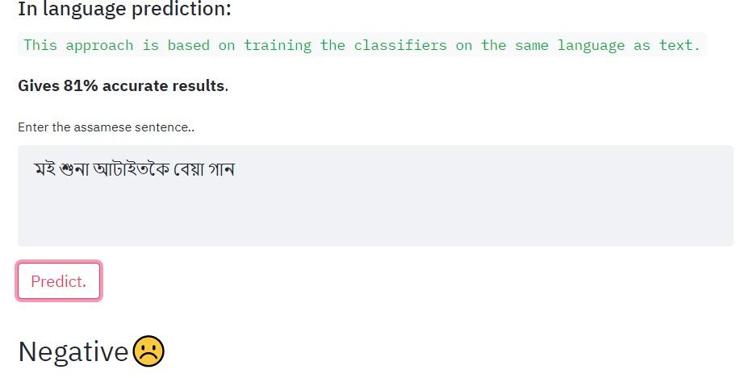
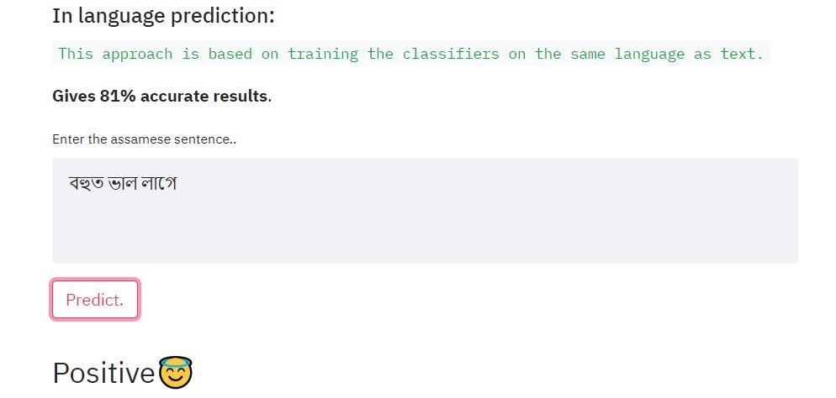
Final Project Glimpses (In-language)

Slide 44
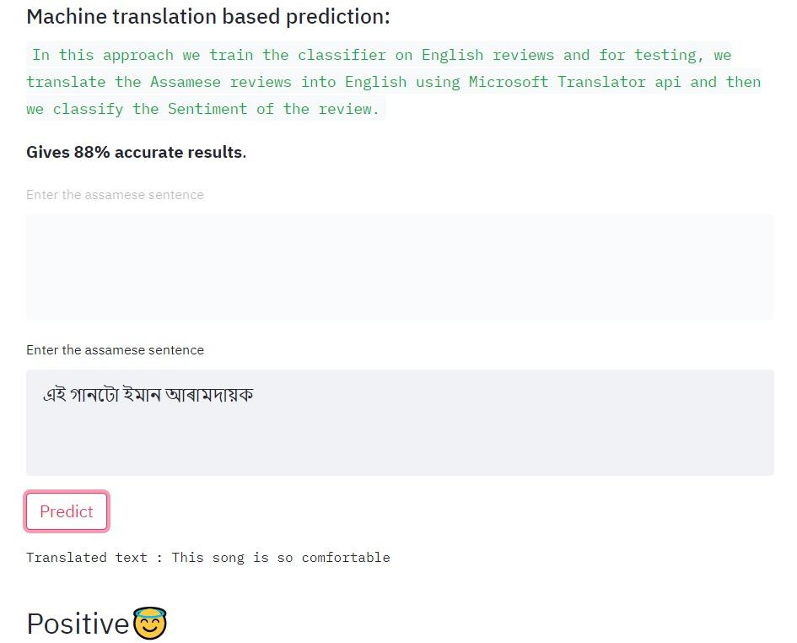
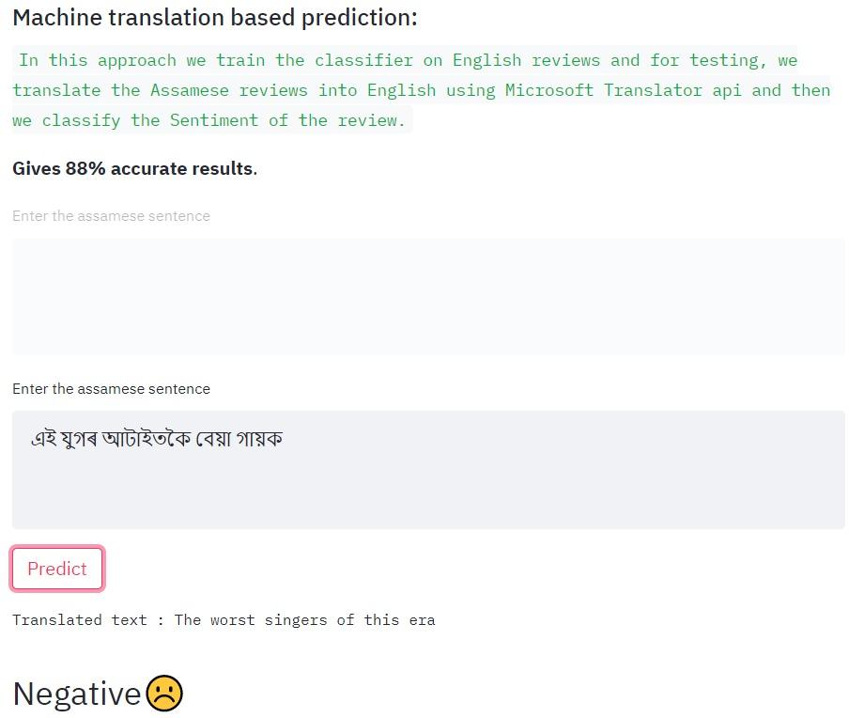
Final Project Glimpses(Machine Translation)

Slide 45
References
[1] Monkey Learn, "Sentiment Analysis," 2021. [Online]. Available: https://monkeylearn.com/sentiment-analysis/. [Accessed 13 August 2021].
[2] Microsoft, "Translator documentation," 2021. [Online]. Available: https://docs.microsoft.com/en-us/azure/cognitive-services/translator/. [Accessed 13 August 2021].
[3] NLTK, "NLTK 3.6.2 documentation," 2021. [Online]. Available: https://www.nltk.org/. [Accessed 13 August 2021].
[4] Noixobdo, "Assamese Stop-word list," 16 March 2011. [Online]. Available: https://noixobdo.blogspot.com/2011/03/assamese-stop-word-list.html. [Accessed 13 August 2021].

Slide 46
[5]S. R. Shah and A. Kaushik, "Sentiment Analysis on Indian Indigenous Languages: A Review on Multilingual Opinion Mining," Preprints, 2019.
[6]Data iku, "Concept Summary: Handling Text Features for ML," 2021. [Online]. Available: https://knowledge.dataiku.com/latest/courses/nlp-visual/text-handling/text-handling-summary.html. [Accessed 13 August 2021].
[7]Streamlit, "The fastest way to build and share data apps," 2021. [Online]. Available: https://streamlit.io/. [Accessed 13 August 2021].
[8] Hinrich Schütze, Christopher D Manning, and Prabhakar Raghavan. Introduction to information retrieval. In Proceedings of the international communication of association for computing machinery conference, page 260, 2008.

Slide 47

THANK YOU

